Slide 1

Seizure Detection & Prediction
CS 534 Final Presentation
Presenter: Chenbin Huang, Min Huang, Mingzhe Hu
11/29/2021
https://github.com/ChenbinHuang/CS534-Final-Seizure

Slide 2

Data & Background
Detection Data
Dog_1 | 418 | 178
Dog_2 | 1148 | 172
Dog_3 | 4760 | 480
Dog_4 | 2790 | 257
Patient_1 | 104 | 70
Patient_2 | 2990 | 151
Patient_3 | 714 | 327
Patient_4 | 190 | 20
Patient_5 | 2610 | 135
Patient_6 | 2772 | 225
Patient_7 | 3239 | 282
Patient_8 | 1710 | 180
Prediction Data
Dog1 | 480 | 24
Dog2 | 500 | 42
Dog3 | 1440 | 72
Dog4 | 804 | 97
Patient1 | 50 | 18
Patient2 | 42 | 18

Slide 3
Feature Extraction: Segment Concatenation (Predict data only)
Segment_1
Segment_2
Segment_n
Channel_1
Channel_1
Channel_1
For
each
Dog/Patient
Channel_2
Channel_2
...
Channel_2
. . .
. . .
. . .
Channel_n
Channel_n
Channel_n
Seg_1
Seg_2
...
...
...
...
...
Seg_n
Concatenate Horizontally

Slide 4
Feature Extraction: Sliding Windows (Prediction data only)
For
each
Dog/Patient
240s
Concatenated Data
160s
80s
240s
...
160s
...
80s
240s
160s
80s

Slide 5
Feature Extraction: Temporal domain & Frequency domain
For each Dog/Patient:
For each Window Set(80s, 160s, 240s)*:
Frequency Domain:
Correlation Matrix (Across Channels): std, mean, eigenvalues, etc.
Band Powers: power_values, max_power, max_avg, etc.
Butter Worth
Filter
240s
160s
80s
Computed features from 240s, 160s, 80s window separately and combined later
Temporal Domain:
Correlation Matrix (Across Channels): std, mean, eigenvalues, etc.
Summary Features: mean, std, abs(mean), rms, kurtosis, skewness
*No need to slide window for detection data
Generate temporal and frequency domain features from each data segment directly

Slide 6
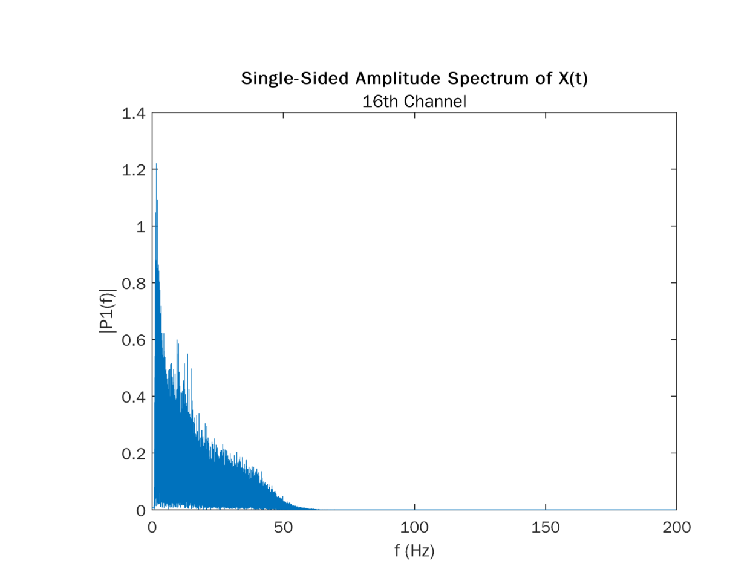
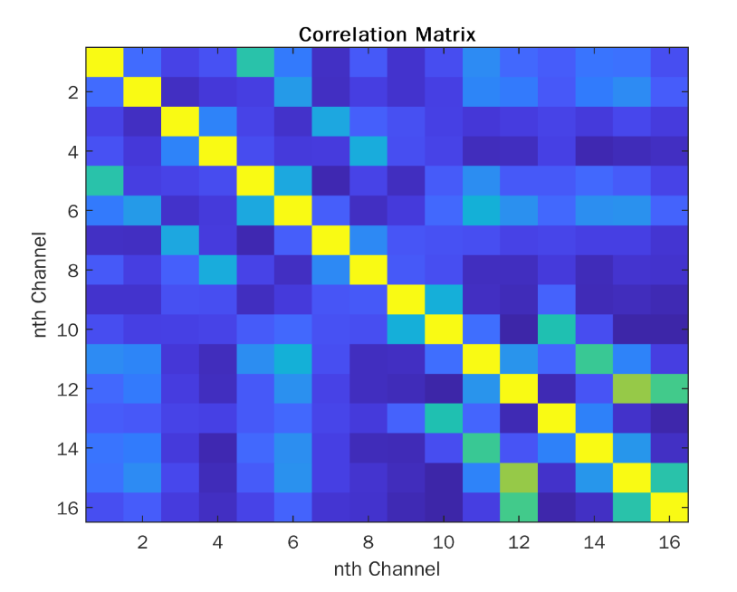

Feature Extraction: Butterworth filtering, Correlation Matrix & Band Limits

Slide 7
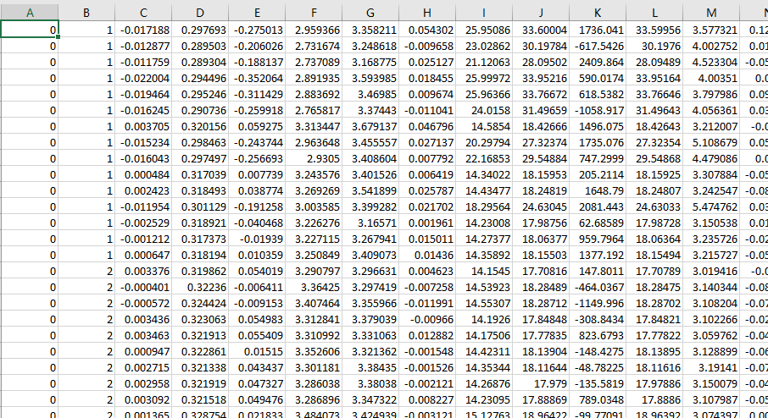
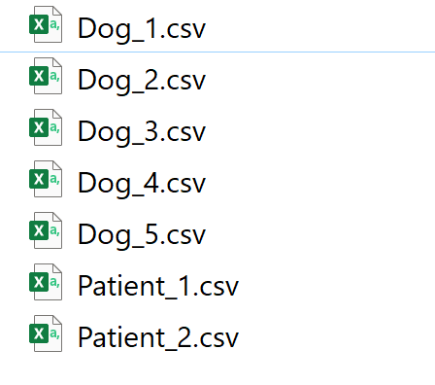
Feature Extraction: Make feature tables
Our prediction/ detection is object-wise
Label Segment Number

Slide 8
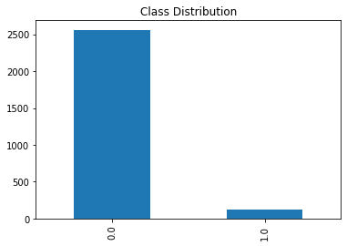
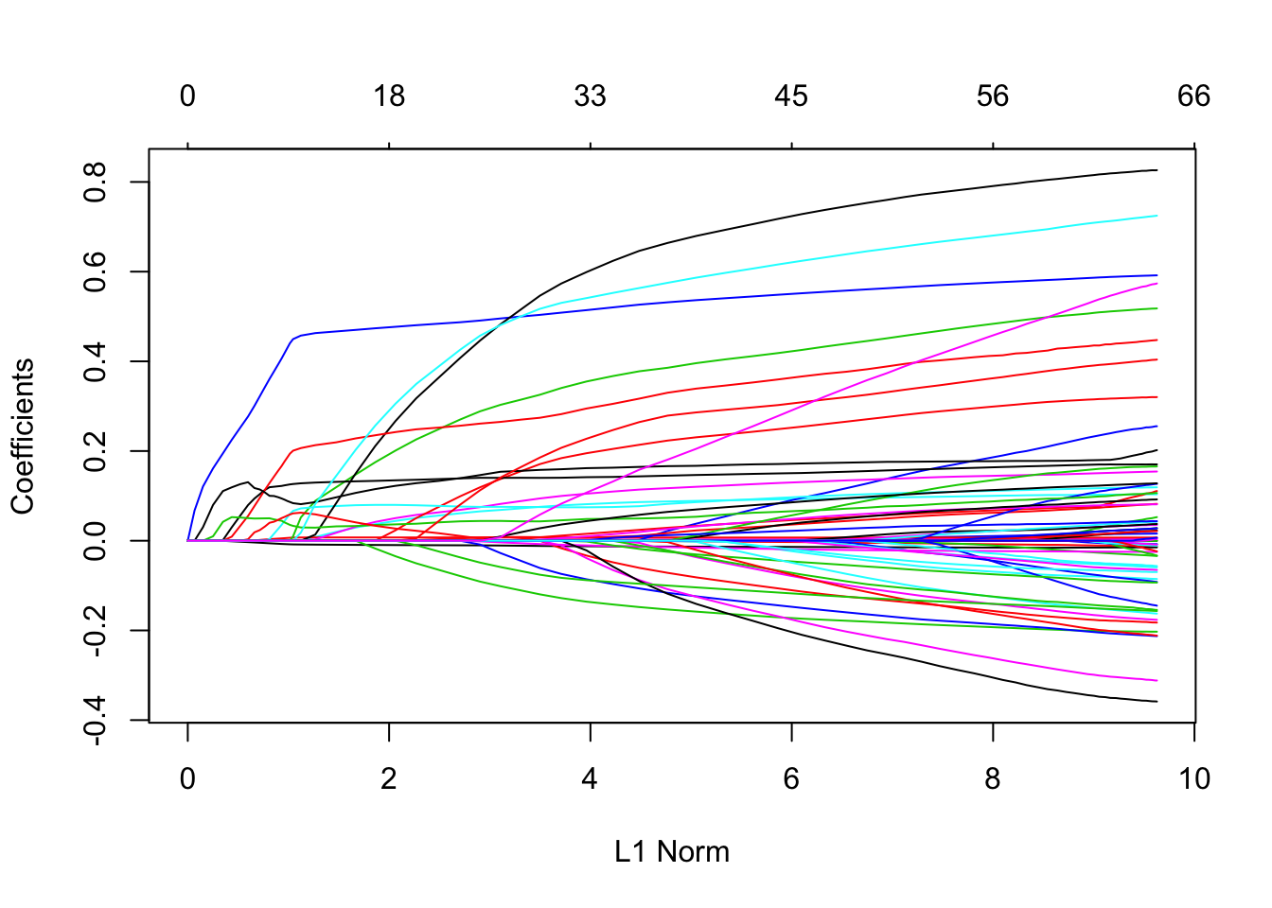
Feature Selection, Oversample & Standardization
Number of Observation(Concat): 2688
Number of features(Concat): 1344
Number of Observation: 2688
Number of features(Reduced): 73
Before SMOTE: {0.0: 2044, 1.0: 106}
After SMOTE: {0.0: 2044, 1.0: 2044}

Slide 9
Results: Seizure Prediction Logistic Regression, Random Forest & Gradient Boosting Classifier
 | AUC |  |  | Precision (Macro/Weighted) |  |  | Recall (Macro/Weighted) |  |  | F1 (Macro/Weighted)
 | LR | RF | GB DT | LR | RF | GB DT | LR | RF | GB DT | LR | RF | GB DT
Dog1 | 0.79 +/- 0.03 | 0.78 +/- 0.03 | 0.73 +/- 0.04 | 0.55/ 0.94 | 0.55/ 0.94 | 0.54/ 0.94 | 0.75/ 0.70 | 0.73/ 0.75 | 0.69/ 0.73 | 0.51/ 0.79 | 0.53/ 0.82 | 0.51/ 0.81
Dog2 | 0.93 +/- 0.01 | 0.97 +/1 0.00 | 0.96 +/- 0.01 | 0.68/ 0.94 | 0.73/ 0.95 | 0.69/ 0.95 | 0.88/ 0.87 | 0.93/ 0.91 | 0.90/ 0.88 | 0.72/ 0.89 | 0.78/ 0.92 | 0.73/ 0.90
Dog3 | 0.96 +/- 0.01 | 0.97 +/- 0.01 | 0.97 +/- 0.01 | 0.66/ 0.96 | 0.71/ 0.97 | 0.68/ 0.97 | 0.91/ 0.91 | 0.92/ 0.94 | 0.92/ 0.92 | 0.71/ 0.93 | 0.78/ 0.95 | 0.74/ 0.94
Dog4 | 0.91 +/- 0.01 | 0.94 +/- 0.02 | 0.92+/- 0.01 | 0.67/ 0.92 | 0.74/ 0.93 | 0.69/ 0.92 | 0.85/ 0.82 | 0.89/ 0.89 | 0.85/ 0.84 | 0.70/ 0.85 | 0.79/ 0.91 | 0.72/ 0.87
Dog5 | 0.99 +/- 0.00 | 0.99 +/- 0.00 | 0.99 +/- 0.00 | 0.86/ 0.98 | 0.85/ 0.98 | 0.87/ 0.98 | 0.98/ 0.97 | 0.99/ 0.97 | 0.99/ 0.98 | 0.91/ 0.98 | 0.90/ 0.97 | 0.92/ 0.98
Patient1 | 0.98 +/- 0.02 | 0.99 +/- 0.00 | 0.99 +/- 0.00 | 0.98/ 0.99 | 0.99/ 1.00 | 0.99/ 1.00 | 0.98/ 0.99 | 1.00/ 1.00 | 1.00/ 1.00 | 0.98/ 0.99 | 1.00/ 1.00 | 1.00/1.00
Patient2 | 0.98 +/- 0.02 | 0.99 +/- 0.00 | 0.99 +/- 1.00 | 0.98/ 0.98 | 1.00/ 1.00 | 1.00/ 1.00 | 0.98/ 0.98 | 0.99/ 1.00 | 1.00 1.00 | 0.98/ 0.98 | 1.00/ 1.00 | 1.00

Slide 10
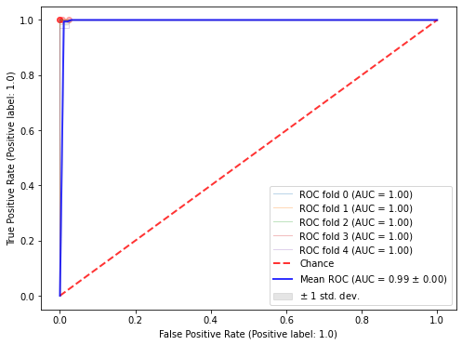
Results: Seizure Detection Logistic Regression, Random Forest & Gradient Boosting Classifier
All the models have good performance, the metrics’ AUC are all above 0.9
Seizure Prediction ROC Dog 1

Slide 11
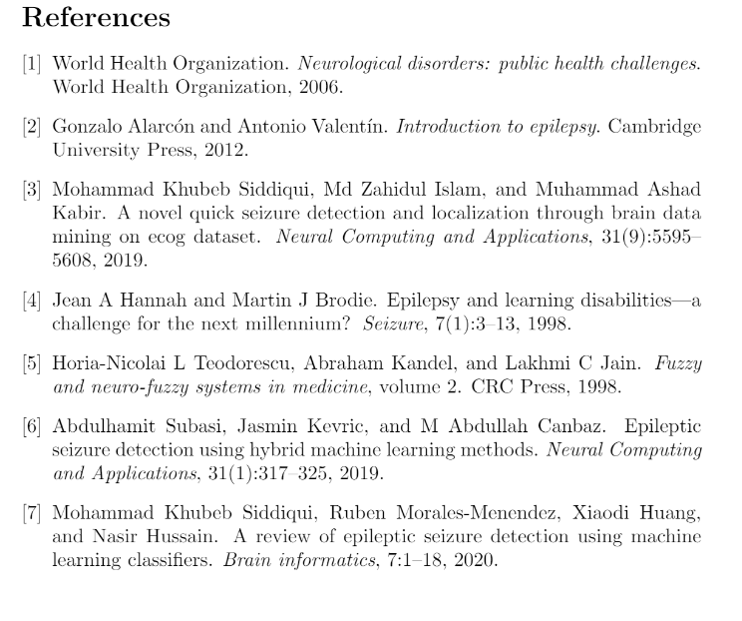

Slide 12
Appendix

Slide 13
Gradient Boosting Decision Tree (GBDT)
Comparable to AdaBoost and Random Forest introduced in the class.
RF: all trees have equal weight, trees are parallel
AdaBoost: trees have different weight, trees updated step by step, next tree will focus more on mistakenly labels samples
GDBT: trees have equal weight, trees updated step by step, next tree will regress on the error of the previous tree

Slide 14
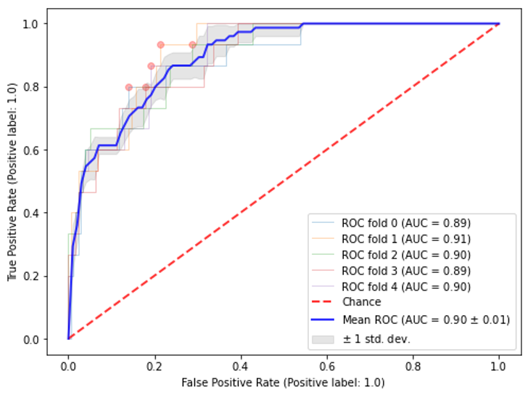
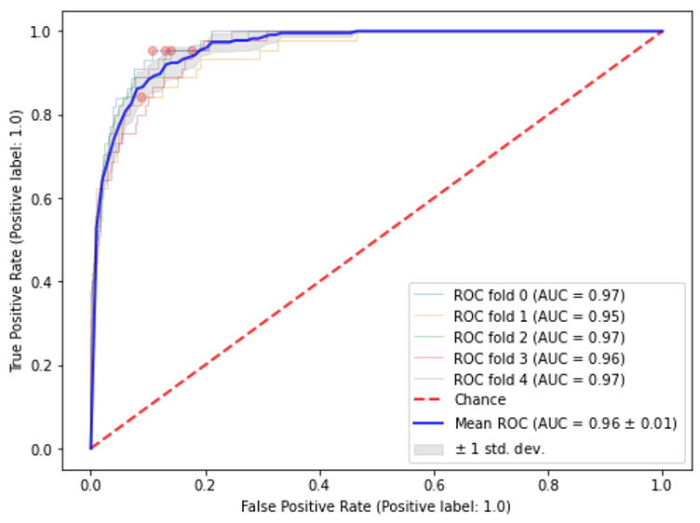
Train with no overlap
Without overlap
With overlap
Sample: Prediction Dog2

Slide 15
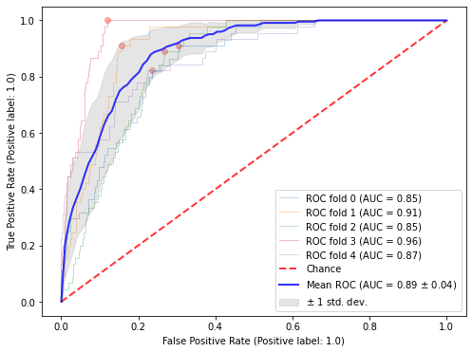
Train and test with inter Hour Data
Inter hour
(train test use data from different hours)
Intra hour
(train test data shuffled, may from same hours)
Sample: Prediction Dog2

Slide 16
SMOTE(Synthetic Minority Oversampling Technique)
get a difference between a sample and one of its k nearest neighbors
multiply by some random value in the range of (0, 1)

